Slide 1
Michigan State University
Office of Financial Aid
Navigating the student Portal
for professional Students
Notes:
Welcome Everyone, My name is Tonya Jamison. I am the Assistant Director for Professional Programs at MSU. Let me have my colleagues introduce themselves.

Slide 2
Goals of the webinar
Where to go
How to navigate
Important screens
Important timeframes
Important facts

Slide 3
Offices and duties
Financial Aid Office - Responsible for advising students regarding the financial aid process. Determines or monitors eligibility for financial aid including student loans, grants, scholarships, and fellowships for students enrolled in classes at MSU.
Controller’s Office/Student Accounts - Responsible for handling your student account. Generates bills, collects payments, and issues refunds for students who have financial aid in excess of university charges.
Registrar’s Office - Responsible for handling student information, enrollment/registration, maintaining a catalog and schedule of classes and enforcing university student policies.

Slide 4
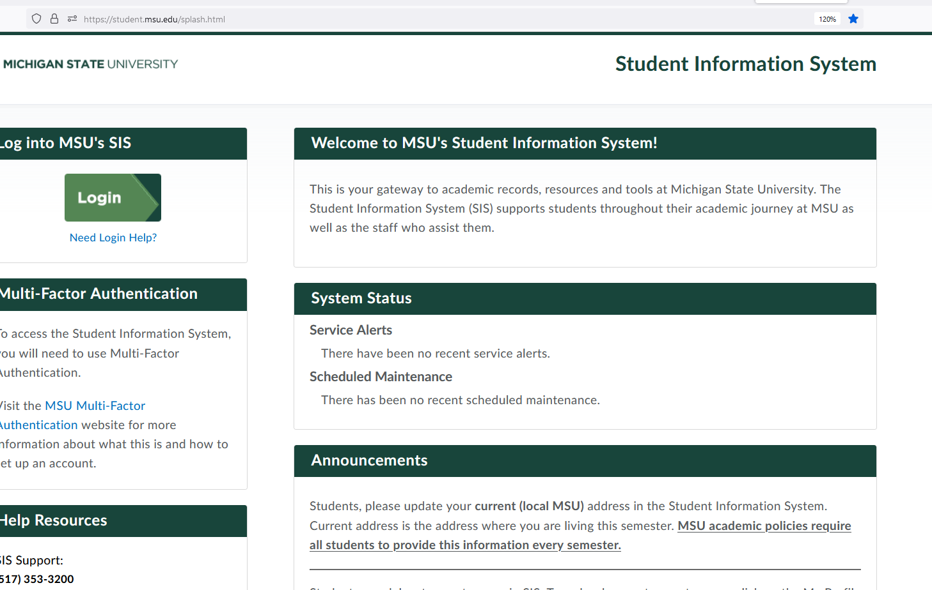
Accessing the Student Portal
Log in to student.msu.edu

Slide 5
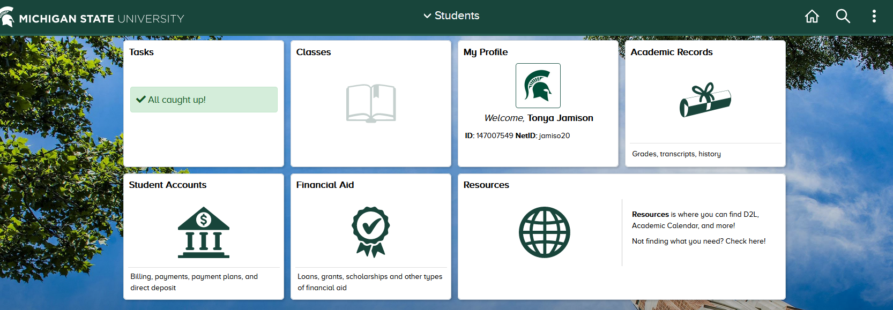
Navigating The landing Page
Access your aid
Access your bill
Access your schedule
Access other relevant information

Slide 6
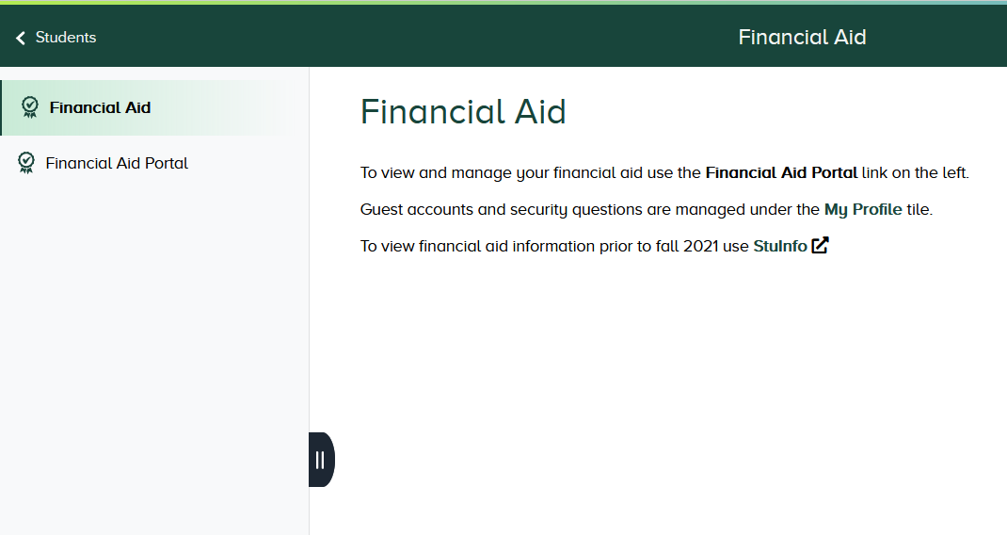
Financial AID Portal
Click the link on the left to access your information

Slide 7
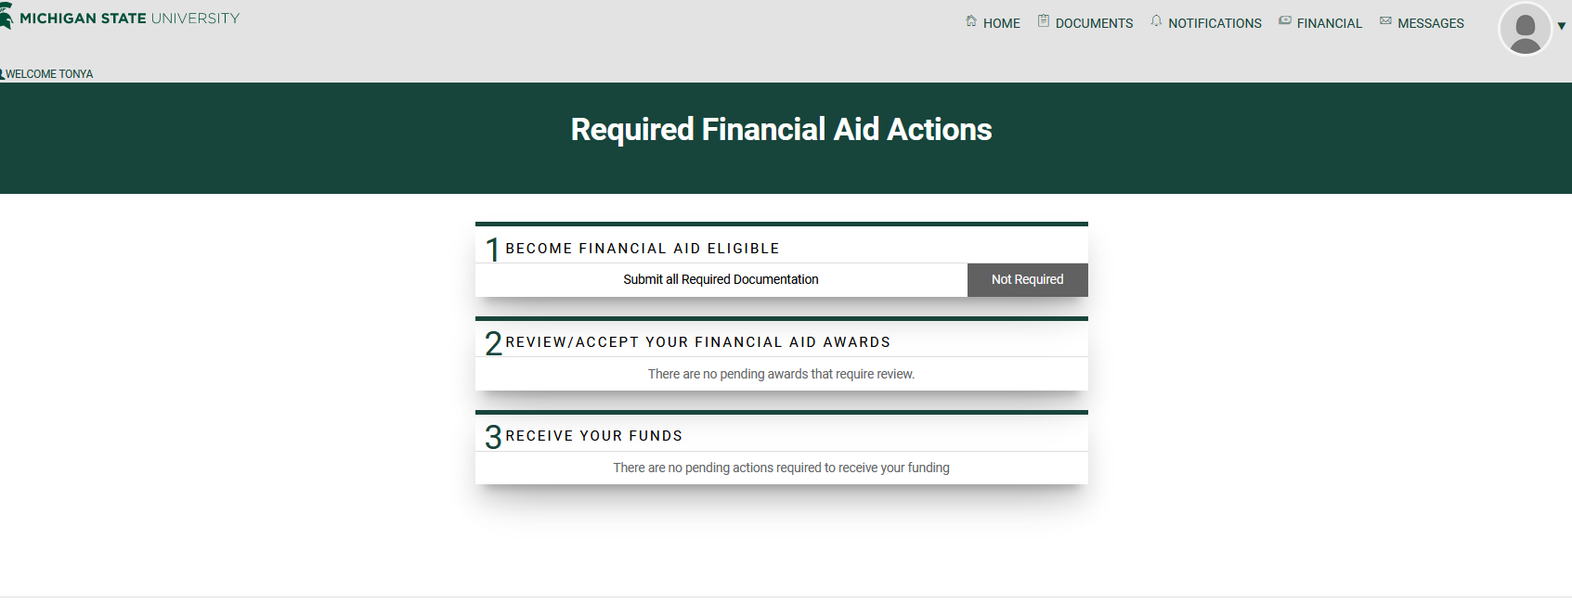
Viewing and accessing information

Slide 8
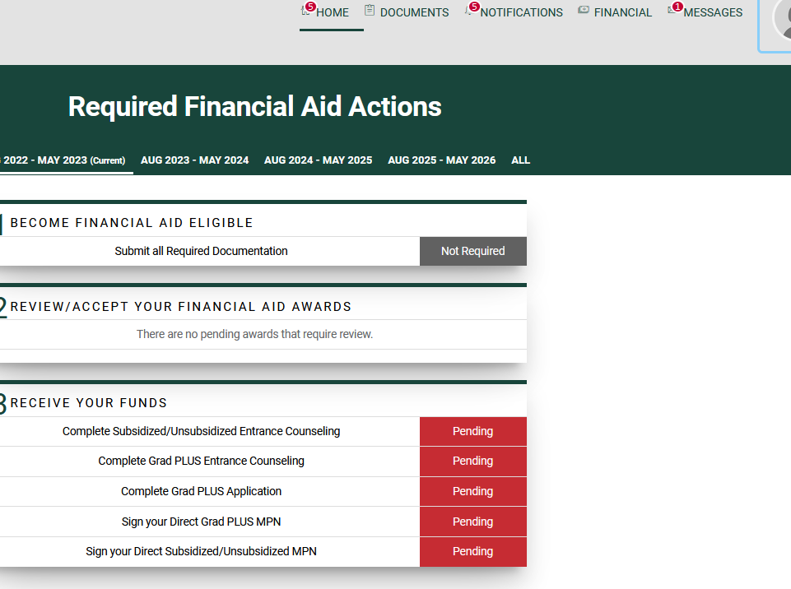
Completing Required Actions
Actions that need to be completed will be highlighted in red.

Slide 9
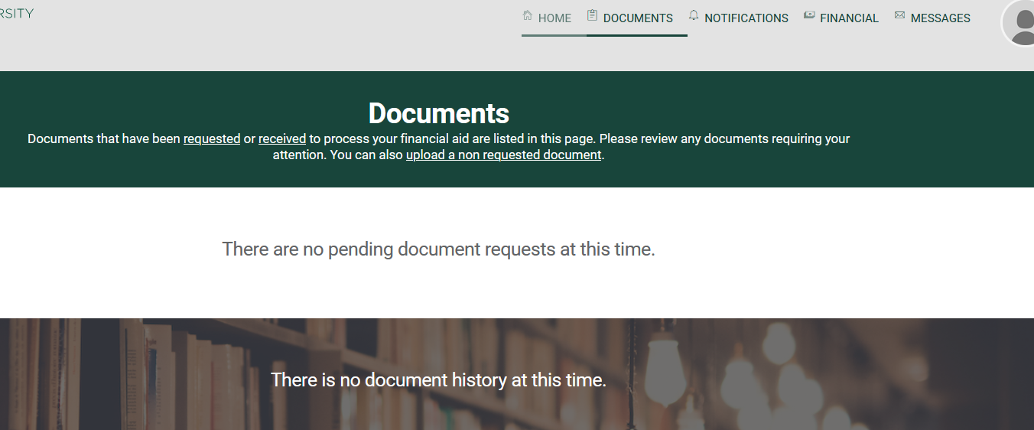
Your Documents

Slide 10
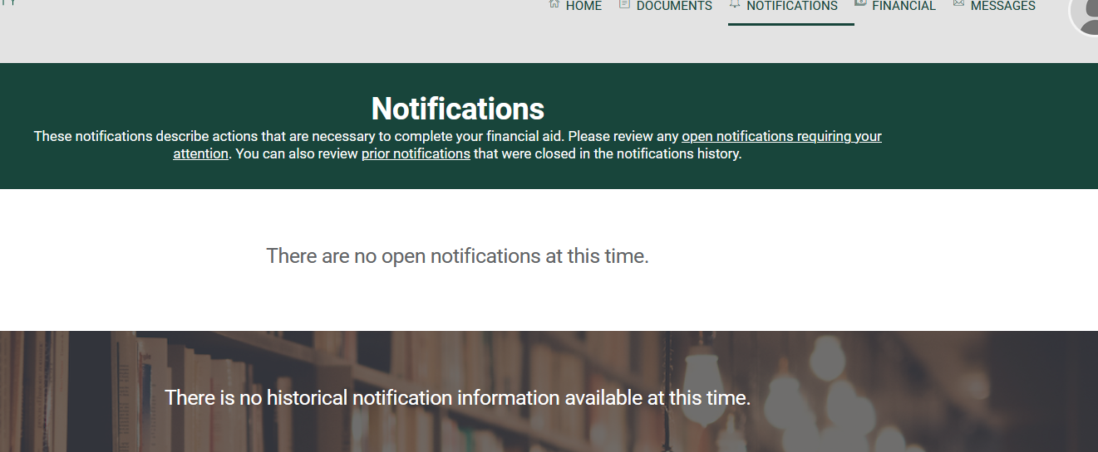
Your Notifications

Slide 11
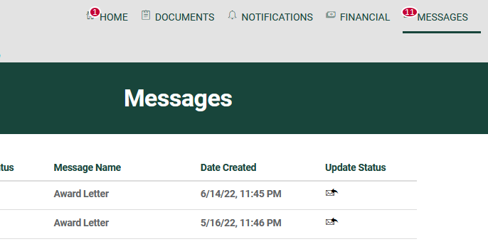
Your Messages
Your award letters and SAP letter are under “messages”

Slide 12
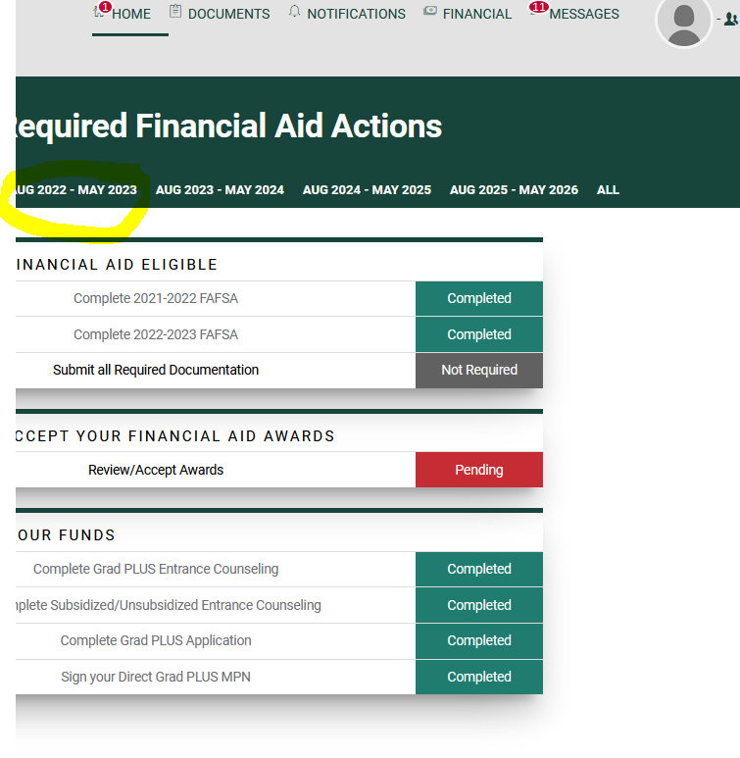
Accepting your loans
Select the correct academic year

Slide 13
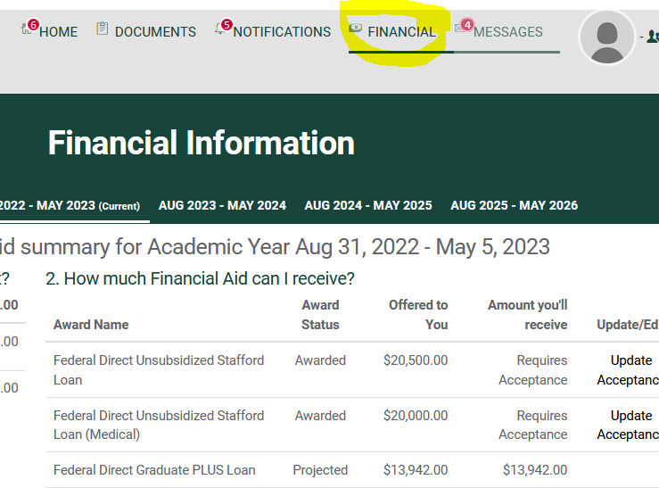
Accepting your LOANS
Click on the “Financial” tab to view and accept your loans
You will accept only unsubsidized loans
Beginning 22-23, Grad Plus loans will be automatically accepted.

Slide 14
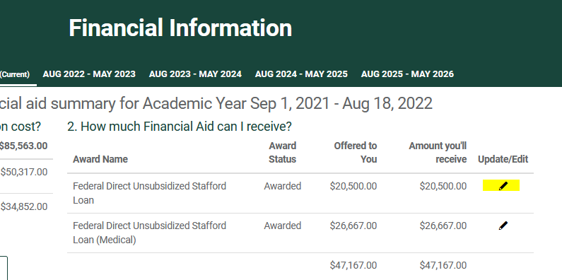
Accepting your Loans
Click on the pencil icon or click “acceptance required”

Slide 15
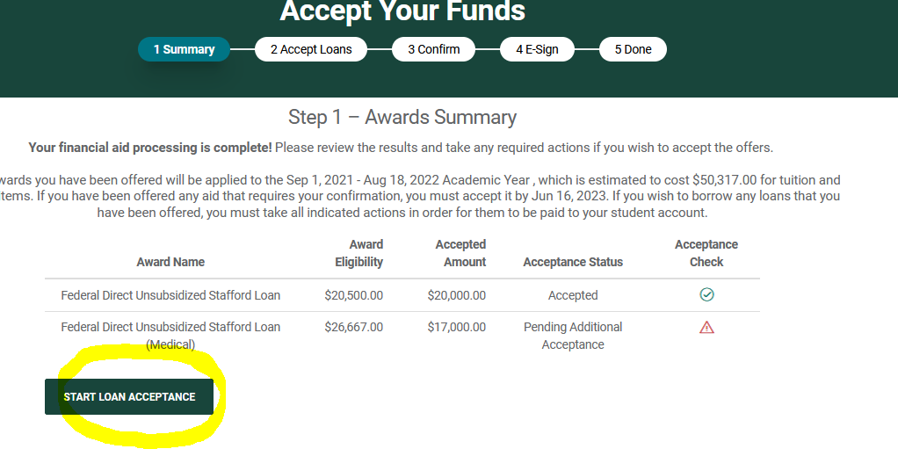
Start Loan Acceptance
Click the “start loan acceptance” box

Slide 16
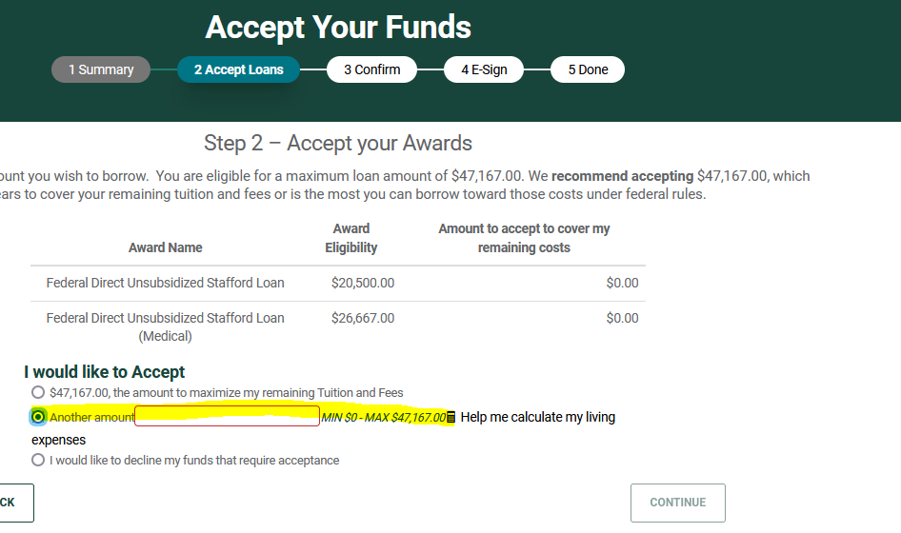
Enter the total amount
Mark the 2nd box and enter the maximum amount

Slide 17
Enter the total amount
You will select the 2nd option

Slide 18
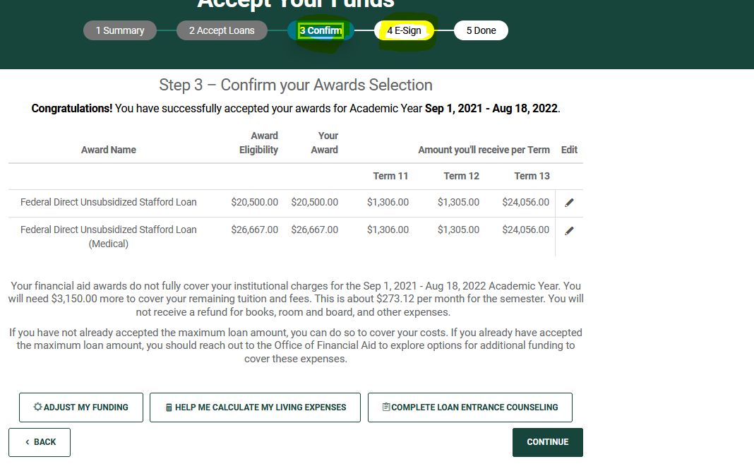
Confirm & Sign
Press the “continue” button 2x and type your name

Slide 19
Grad Plus & health professional loans
Require an application and approval
Grad PLUS loans
Apply at www.studentaid.gov
Subject to credit check and approval
Available for specific terms
Fall/Spring - September to May
Summer – June to July
Beginning fall of 2022 - PLUS loans are auto accepted for the amount on the application
Call financial aid before editing or changing an existing application
Health Professional loans
Application through a link via our third-party vendor ECSI.
The loan must be accepted in the student portal after application approval

Slide 20
Terminology
Award Status
Projected/Estimated – This amount is an indication of your potential eligibility per your program and financial aid application. It is not official, and an action must be taken
Awarded – This indicates that the funds are ready to be accepted
Anticipated Aid – This is a placeholder amount listed in student accounts for all eligible and accepted aid that is forthcoming. These funds have not been applied to your bill.

Slide 21
Terminology
Disbursements – Are when financial aid (i.e. grants, loans, or scholarships) funds are forwarded to student accounts by the financial aid office.
Timeframes for disbursements
Scholarships/Grants/Fellowships – Added to student’s account per university rules
Federal Aid - cannot be released no more than 10 days before a standard term begins
Federal aid disbursements begin 10 days before the standard term begins. For example, if the university standard term starts on 8/31, disbursements are sent to student accounts ten days earlier on 8/21.
This does not mean that you will receive a refund on that day. It just means that accounts start being paid.
Refunds – Are funds in excess after your student accounts’ bill has been paid.
Refunds are generated twice weekly in the first three weeks of the term and then once a week, thereafter.
Direct deposit is the fastest way to ensure timely receipt of refunds.

Slide 22
Timeframes to remember
If your term starts before the standard academic term and funding will be delayed, please consider a short-term loan
You should accept your aid no later than two weeks before the semester begins
Allow for processing time of one to two weeks when requesting loan funds
You cannot accept loan funds for a semester after the semester ends
Loans should be accepted two weeks prior to the end of the term in order to ensure review and processing of your application

Slide 23
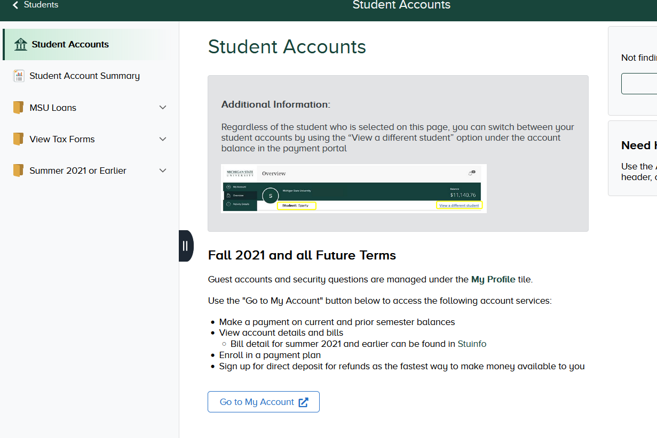
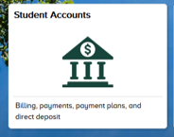
Student Accounts Tab
Use the student account tab on the student.msu.edu landing page to view your bill and statements
Once at “Student Accounts,” click on “Go to My Account”

Slide 24
Setting up Direct deposit
Sign up option
Terms & Conditions

Slide 25
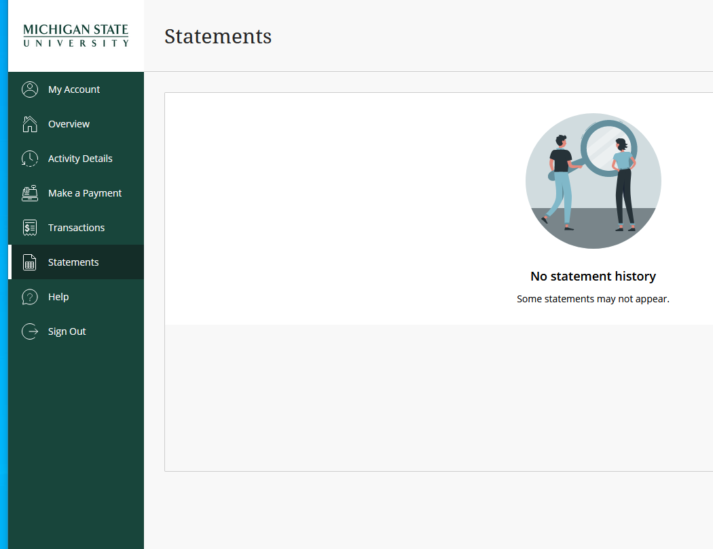
To view a Statement
Click on the “Statements” tab

Slide 26
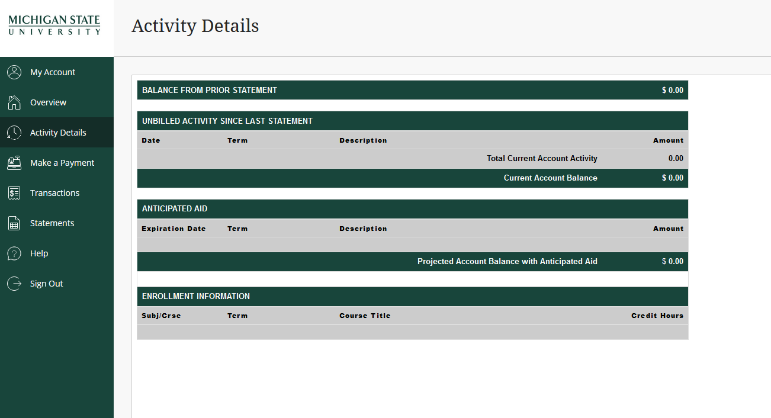
To view specifics
Use the “Activity Details” tab. This information is updated regularly and is more current than your statement.

Slide 27
To make a payment
Use the “Make a Payment” tab. This will display your payment information.

Slide 28
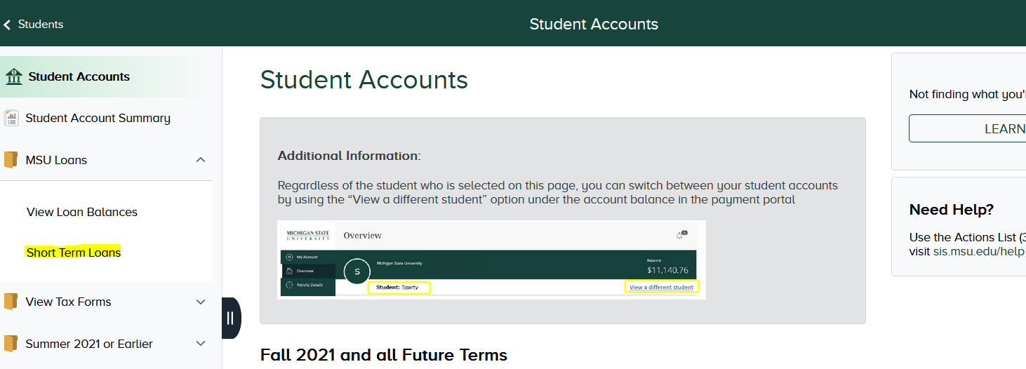
Short-term Loans
If you have bills that need to paid prior to receiving your refund, you do have the option of applying for a short-term loan in the amount up to $1,700 (medical students). Loans need to paid back within 60 days.
The application is available through the student account tile in the student portal
*If you meet the criteria, you will be approved, and your funds will be directly deposited into your bank account. If not, you will need to pick up your loan proceeds at the administration bldg.
**You will need to pay back the funds with your aid refund. This is not done automatically.**

Slide 29
Recap
Students must be enrolled for at least ½ time in order to receive financial aid
Financial aid disburses funds to student accounts and the funds are applied to your bill.
This process is not immediate
While many refunds are processed before the start of the term, different programs can see delays in refunds availability
Consider a short-term loan to help cover the gap period
The exact amount of refunds will vary from student to student
If you are applying for financial aid via the FAFSA, this is done every year at studentaid.gov.

Slide 30
Recap
Student accounts issues refunds on a scheduled days not financial aid
The bill is a snapshot in time. Check activity detail for current account status
If you have billing questions, please contact student accounts
To receive your refund faster, set up direct deposit in your student portal.
http://ctlr.msu.edu/costudentAccounts/Direct_Deposit.aspx
Direct deposit refunds are received by your bank within 1-3 business days after they are processed by student accounts.

Slide 31
contact Information
Financial Aid
Phone: 517-353-2401
Email: ofamed@msu.edu
Website: www.finaid.msu.edu
Controller’s office/student Accounts
Phone: 517-355-3343
Email: Student.receivables@ctlr.msu.edu
Website: www.ctlr.msu.edu/costudentaccounts

Slide 32
Questions?

Slide 33
THANK YOU!

